Slide 1
IBM Data Science Professional Certificate Coursera Capstone IBM Applied Data Science Capstone
Best Suburb to Open a Cafeteria in Melbourne, Australia
By: Piyal Banik
Date: 8th February, 2021

Slide 2
Business Problem
Choice of location is one of the most important factors that decide whether a Cafeteria will be successful or not.
In this project we aim to solve the above mentioned problem where a person willing to invest in a new cafeteria faces.
The main goal of this project is to collect and analyse data in order to select a location in Melbourne, Australia to open a Cafeteria.

Slide 3
Data Requirements
We would need the following data:
List of Suburbs in Melbourne
Latitude, Longitude of each suburb
Various venues present in each suburb
Sources of the data
Wikepedia page for extracting the suburb name https://en.wikipedia.org/wiki/Category:Suburbs_of_Melbourne
Geocoder package for latitude and longitude coordinates
Foursquare API for venue data

Slide 4
Methodology
Step by Step procedure:
Web Scraping using BeautifulSoup Package
Retrieving latitude and longitude using Geocoder
Using Foursquare API to get venue data
Data Analysis to extract only the Cafeteria data
Use K-Means clustering on the data
Visualise the data on a map using Folium

Slide 5
Results
We categorised the data into 3 categories using K-means clustering based on frequency of occurrence for ‘Cafe’.
Cluster 0: Suburbs with low number of Cafes.
Cluster 1: Suburbs with moderate number of Cafeterias.
Cluster 2: Suburbs with high concentration of Cafeterias.

Slide 6
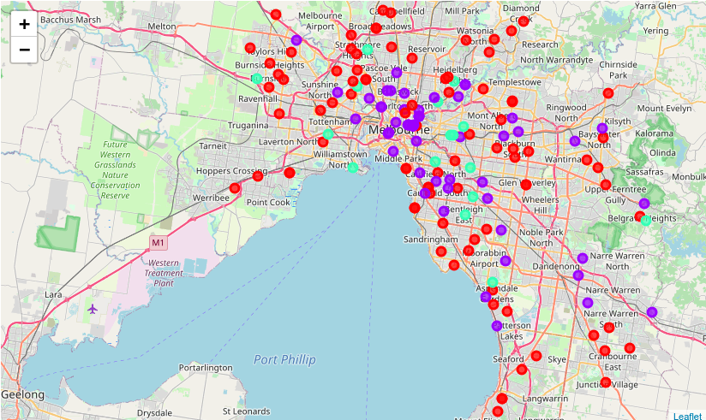
Results

Slide 7
Recommendation
Most of the Cafeterias are concentrated in or around the Melbourne CBD which is displayed in Cyan color and is the cluster 2.
Cluster 0 is displayed as red color and have the lowest number of cafes in those suburbs. Although this represents a greater opportunity and high potential but also suffer from the risk of having fewer customers as those areas are not as busy as the ones in Cluster 2 and 1.
As a new business owner it wouldn’t be wise enough to choose cluster 2 . Therefore, we would recommend that cluster 1 should be chosen where there are medium competition but greater opportunity.

